Slide 1
Modeling the exploitation and mitigation of memory safety vulnerabilities
Breakpoint 2012
Matt Miller
Microsoft Security Engineering Center

Slide 2
Acknowledgements
Richard Tuffin, Julien Vanegue | For their insights and collaboration on classifying memory safety and exploitability
Related work
Automated/semi-automated exploit generation [1,2,3,16] | Thanassis Avgerinos, David Brumley, Sean Heelan, Edward Schwartz
Memory safety classification & abstract models for exploitation [9,10,11,12,13] | Patroklos Argyroudis, Sandeep Bhatkar, Eep Bhatkar, Sergey Bratus, Daniel C. Duvarney, Halvar Flake, Michael E. Locasto, Chariton Karamitas, Meredith L. Patterson, Len Sassaman, R. Sekar, Anna Shubina, Ryan Smith, Chris Valasek
Automated post-mortem analysis of exploitability [4,15] | Adel Abouchaev, Richard van Eeden, Nitin Kumar Goel, Damian Hasse, Scott Lambert, Lars Opstad, Andy Renk, Jason Shirk, Dave Weinstein, Mark Wodrich, Greg Wroblewski

Slide 3
Let’s start with three assertions
1. Assessing the exploitability of memory safety vulnerabilities is a hard problem
Today, an exploit must be written to prove exploitability (does not scale) or a conservative guess must be made (may overestimate)
2. There is no robust taxonomy for classifying the invariants of a memory safety flaw
CWE[7] can be used to classify a flaw’s type, but not its invariants (which influence the flaw’s exploitability)
3. You cannot improve on #1 without first addressing #2

Slide 4
Current methods for determining exploitability
Rule-based crash analysis
Automatic exploit generation
Examples: !exploitable[4], CrashWrangler[5]
Examples: APEG[2], AEG[3], and others[1]
Automated
Issue: conservative, limits prioritization
Issue: immature, limited applicability
Is there a middle ground?
Policy-based classification
Manual exploit generation
Manual
Example: all write AVs are exploitable
Examples: numerous ☺
Issue: conservative, limits risk mgmt
Issue: costly, does not scale
Imprecise
(exploitability estimate)
Precise
(exploitability proof)

Slide 5
Challenges in exploitability assessment
Software vendors must generally be conservative and coarse-grained when estimating exploitability
(!exploitable and Microsoft’s Exploitability Index [4,6])
Risk is often over-estimated[14]
Vendor must assume exploitable by default
Difficulty of exploitation must be generalized
Reliant on manual estimation which is non-ideal
May be error prone, inconsistent, and hard to verify
Individuals must have exploit expertise or be conservative
Hard to measure impact of mitigations (ex: DEP/ASLR)
Limits patch deployment prioritization for vendor and customers
Researchers must agree with the vendor’s assessment or concretely demonstrate exploitability
May create tension between both parties
May discourage reporting of legitimate issues

Slide 6
Proposing a way forward
To overcome these challenges, we need a method of assessing exploitability that is…
Accurate | The assessment is correct
Precise | Provides a granular assessment of exploitability that is aware of contextual factors
Objective | The assessment is consistent, repeatable, and can be independently reviewed
Scalable | Human involvement is minimized
An abstract model is one method that could be used to achieve this
Specify the invariants of a flaw and the contexts it may be triggered in
Simulate exploitation using a memory safety model
Output contextual measures of exploitability

Slide 7
Modeling memory safety

Slide 8
What is memory safety?
We have many terms for
memory safety issues
We have many terms for
memory safety defenses
But how do they map to exploitability?
Buffer overrun, uninitialized use, type confusion, … [7]
?
/GS, /SAFESEH, …
Read AV, write AV, write4, writeN, execute AV, …
DEP, ASLR, SEHOP, …
Temporal/spatial memory access errors[8]
We need a more rigorous taxonomy if we want to be able to measure exploitability

Slide 9
Fundamental concepts in memory safety
Memory-safe: a memory access that is within bounds and refers to an object that is in a valid state
Lead to
Flaws
Violations
Vulnerabilities
Enable
Result in
Buffer overrun
Read
Elevation of Privilege
Uninitialized use
Write
Information Disclosure
Type confusion
Execute
Denial of Service
A flaw is the root cause of a vulnerability and directly enables one or more violation
A violation is an unsafe memory access that may lead to one or more subsequent violation
The maximum security impact of a flaw based on the violation(s) that are enabled

Slide 10
Classifying memory safety flaws
The taxonomy is generally agreed upon for memory safety flaws (e.g. CWE[7,8])
Arithmetic errors
and other 2nd order issues can expose memory safety flaws
Boundary error
Type confusion
Uninitialized use
Buffer overrun
Buffer overread
Out-of-bounds array index
Invalid type cast
Invalid union field access
Use after free
Double free
Uninitialized memory access
Each flaw can be mapped to the set of violation(s) that it enables
Temporal
Spatial

Slide 11
Classifying memory safety violations
The properties of an unsafe memory access are a convenient way to describe a violation
Two properties establish the basic types of violations
Extended properties add more precision
Memory access method
Memory access parameter state
Property | Values
Addressing mode | absolute, relative
Direction | forward, reverse
Initial displacement | post-adjacent, pre-adjacent, …
Base region type | heap, stack, …
Execution domain | user, kernel
Locality | local, remote
…
Parameter
Base (b)
Content (c)
Displacement (d)
Extent (e)
State
Controlled (c)
Fixed (f)
Uninitialized (u)
Unknown (?)
r
w
x
w-bc-cc-df-ef
Write, base and content are controlled, displacement and extent are fixed

Slide 12
Modeling exploitation & mitigation techniques
An exploitation technique enables a transition from one type of violation to another
Canonical exploitation technique: stack return address overwrite
Write violation
Corrupt return address
Return from function
Execute violation
Return address corrupted
GS cookie matches?
w-bf-cc-df-ec
GS cookie matches?
r-bf-cc-df-ef
x-bc-c?
A mitigation technique introduces new constraints on these transitions

Slide 13
Exploitation primitives
There is a finite set of primitives for transitioning between the basic types of memory safety violations
Transition | Primitives
r → r | Read value used as base, displacement, and/or extent of a subsequent read
r → w | Read value used as base, content, displacement, and/or extent of a subsequent write
r → x | Read value used as base of an execute
w → r | Corrupt memory used as base, content, displacement, and/or extent of a subsequent read
w → x | Corrupt writable code and execute it
x → x | Execute with a controlled base and/or content
Read
Write
Execute
Exploitation techniques combine these primitives in different ways to reach a desired end state

Slide 14
Vulnerability classification

Slide 15
A typical vulnerability triage workflow
An uninitialized function ptr is read
from the freed object leading to an
execute violation. The read does not
lead to a subsequent read or write.
Challenges with this workflow
How do you identify the “terrain” of violations to explore?
How do you explore that terrain consistently and completely?
How do you deal with and convey unknowns?
How can you do this without requiring exploitation expertise?
A constant is written to freed mem,
but the subsequent violations
are unknown as they depend on
what is corrupted by the write.
Read violation
Read violation?
Execute violation
Read violation
Use after free
Write violation
…
…
Write violation
Object *p = new Object();
…
delete p;
…
if (x) { p->value = 0; }
else { p->OnCompleteCallback(); }
Execute violation?
1. Determine the root cause (the flaw)
2. Explore violations enabled by the flaw
3. Stop when exploitable violation found

Slide 16
VEXClass: a vulnerability classification assistant
VEXClass is a proof of concept tool that adds more structure to the vulnerability triage & classification process
Enables uniform and consistent classification
Provides a map of the terrain to explore
Facilitates more precise exploitability analysis
Well-defined model for flaw and violation invariants
Supports expression of “known” unknowns
Classification output is normalized & easily reviewed
Can be used as a “checklist” for the triage process
Helps ensure that all possibilities are considered
Analysts do not need state-of-the-art exploitation expertise
Classification output is used as input for exploitability analysis
Separates classification process from exploitability assessment
Advances in exploitation do not require re-classification

Slide 17
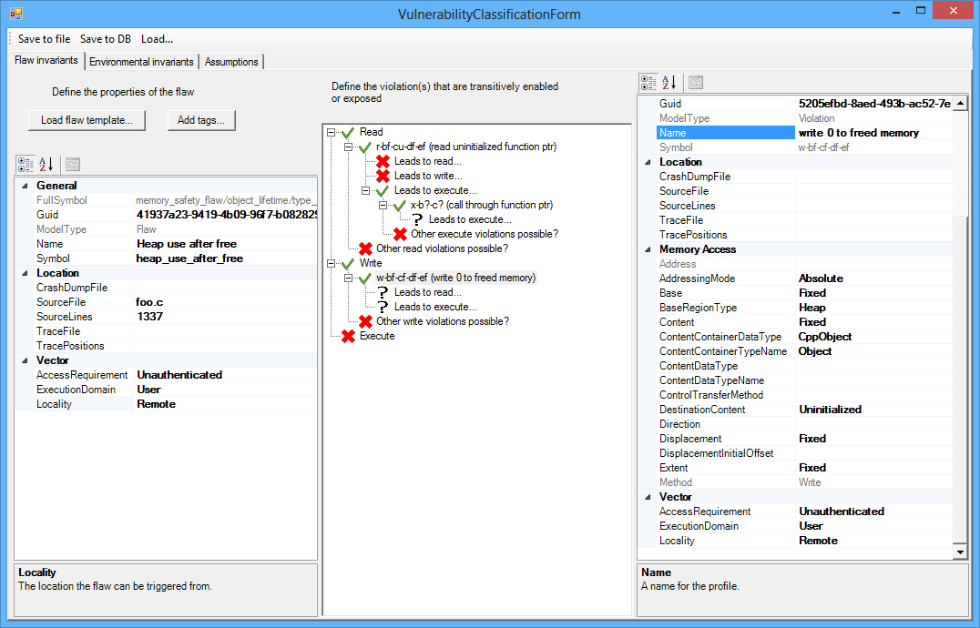
Describe the invariants of each violation to inform the exploitability analysis
It is not a requirement to specify all properties
Define the violations that are confirmed possible, may be possible, or are not possible
Describe the invariants of the flaw

Slide 18
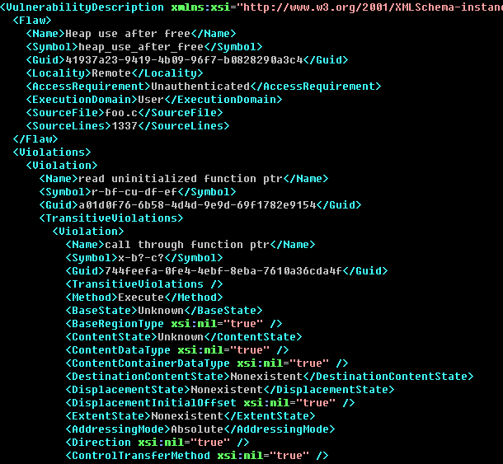
Example output
Normalized classification output enables information sharing and exploitability analysis
(without giving away specific details of the issue)

Slide 19
VEXClass Demo

Slide 20
Measuring exploitability

Slide 21
Measuring exploitability via an abstract model
The invariants of a violation form part of the initial state that is used to measure exploitability
Initial State
Simulate Exploitation
Exploitable Path(s)
Violation invariants
r
r
Chain of violations that reach desired state (ex: code exec)
Constraints that must be satisfied
Exploitability metrics
Environmental invariants
(hw, os, app)
w
w
Assumptions
(attacker abilities, …)
x
x
e(s) : S → S
This model quantifies exploitability based on the probability that a sequence of exploitation techniques will succeed

Slide 22
Simulating exploitation
A state machine (NFA) is a convenient way to model exploitation
Each state is composed of the invariants of a violation and the context it is triggered in
Exploitation techniques define the transition function from one state to another
Each transition has zero or more constraints that can be probabilistically satisfied
Violation | w-bf-cc-df-ec
Application | Internet Explorer 9
OS | Windows 7 SP1
HW | x86 + pae
… | …
w
r
Corrupt ret addr
w
0.1
r
0.5
x
r
x
Jump to ret addr
0
r
…
…
One technique is exploitable 5%
of the time, the other not at all
Simulation runs until reaching a fixed point [$e\left(s\right)=s$] or a desired end state (e.g. code execution)

Slide 23
Examples of exploitation techniques
Stack return address overwrite
$$s_{1}$$
$$s_{2}$$
$$s_{3}$$
w-bf-cc-df-ec
corrupt ret addr
r-bf-cc-df-ef
return from func
x-bc-c?
Constraints:
Can corrupt return addr?
Known disp. to return addr?
Constraints:
Can trigger function return?
Can bypass stack cookie?
Uses a w→r and r→x primitive
to transition from a controlled
content write to an execute with
a controlled base
Convert a relative write into an absolute write
$$s_{1}$$
$$s_{2}$$
$$s_{3}$$
w-bf-cc-dc-ef
corrupt write base
r-bf-cc-df-ef
write using base
w-bc-c?-df-ef
Constraints:
Can corrupt write base?
Known disp. to write base?
Constraints:
Can trigger memory write?
Uses a w→r and r→w primitive
to transition from a write with
a controlled displacement to a
write with a controlled base

Slide 24
Examples of exploitation techniques (II)
Corrupt C++ virtual table pointer via use after free
$$s_{1}$$
Read uninit
vtable ptr
$$s_{2}$$
Call virtual
method
$$s_{3}$$
r-bf-cu-df-ef
r-bu-c?-df-ef
x-b?-c?
Constraints:
Can initialize vtable ptr?
Can trigger virtual call?
Constraints:
Can initialize vfptr?
Uses a r→r and r→x primitive
to transition from an uninitialized
read to an execute
Seed uninitialized content
$$s_{1}$$
seed uninitialized
content
$$s_{2}$$
*-*-cu-*-*
*-*-cc-*-*
Constraints:
Can position content?
Translates a violation with
uninitialized content into one
with initialized (controlled) content
Combined
r-bf-cu-df-ef
r-bf-cc-df-ef
r-bc-c?-df-ef
x-b?-c?

Slide 25
Examples of exploitation techniques (III)
$$s_{1}$$
Transfer control
to data
$$s_{2}$$
Execute data as code
x-bc-c?
x-bc-cc
Constraints:
Can execute data as code?
Execute ROP stage to arbitrary code
$$s_{1}$$
Transfer control
to ROP payload
$$s_{2}$$
Transfer control
to arb. code
$$s_{3}$$
x-bc-c?
x-bc-cf
x-bc-cc
Constraints:
Can find address of gadgets?
Can pivot stack pointer?
…
Constraints:
Can allocate WX memory?

Slide 26
Chaining exploitation techniques
Exploitation techniques can be chained together to reach a desired end state
Example #1: stack buffer overrun
Example #2: C++ object use after free
From violation | Transition | To violation
w-bf-cc-df-ec | corrupt ret addr | r-b?-cc-d?-e?
r-b?-cc-d?-e? | return from func | x-bc-c?
x-bc-c? | load non-ASLR img | x-bc-cf
x-bc-cf | execute ROP stage | x-bc-cc
From violation | Transition | To violation
r-bf-cu-df-ef | init vtable ptr | r-bf-cc-df-ef
r-bf-cc-df-ef | read vtable ptr | r-bc-c?-d?-e?
r-bc-c?-d?-e? | spray vtable | r-bc-cc-d?-e?
r-bc-cc-d?-e? | call virt method | x-bc-c?
x-bc-c? | load non-ASLR img | x-bc-cf
x-bc-cf | execute ROP stage | x-bc-cc
Exploitability of both chains depends on probability of satisfying the constraints of each transition

Slide 27
Simulation Demo

Slide 28
Applying this model
Measuring value, guiding investments, and improving risk assessment

Slide 29
Measuring the value of defensive technologies
No established system exists to measure the impact of defensive technologies like as DEP, ASLR, and /GS
Impact is often measured based on the ability to break techniques used by public exploits[18]
E.g. “exploit X would not have worked with mitigation Y in place”
A model of exploitation can be used to concretely measure the impact of defensive technologies
E.g. “with mitigation Y in place, the exploitability in a given scenario is Z”
Impact is measured based on past behavior
Absence of relevant exploits can be problematic
Hard to justify new tech without data
Does not quantify difficulty of exploitation after enabling mitigation
Impact measurement is hindsight only
Impact is measured based on possible behavior
Open to scrutiny, refinement, and customization
Impact may change because of new exploitation techniques
Facilitates more rigorous “what-if” scenarios
E.g. exploring value of a new mitigation

Slide 30
Guiding defensive investments
Invest in detection & mitigation of flaw types that are
most easily exploited & most likely to exist
Invest in mitigations for exploitation techniques that are key to exploiting many types of flaws
High impact investment
Most likely to exist
Flaw #1
Flaw #2
Flaw #3
Most easily exploited
Probability of a flaw type existing
Key techniques
Code execution
Probability of exploiting a flaw type

Slide 31
Improving risk management
A model of exploitation could enable more granular and effective risk management
Enable level of acceptable risk to be customized based on assumptions about an attacker’s abilities
Provide a measure of exploitability for each affected product version rather than generalizing
Provide an objective description of exploitability that can be more easily agreed upon or refuted
Enable continuous and transparent refinement based on changes in the state of the art

Slide 32
Conclusion & next steps
Conclusion
Measuring risk associated with memory safety vulnerabilities is challenging
Often requires conservative analysis which may not reflect actual risk
An abstract model of memory safety could help improve on this situation
Provide a measure of exploitability that enables more effective risk mgmt
Next steps
Feedback: this is where you come in ☺
Any and all feedback welcome, especially critical feedback!
Have something that would be hard to model? I want to hear about it!
Continue to refine the current prototype of the model described today

Slide 33
Questions?

Slide 34
© 2012 Microsoft Corporation. All rights reserved. Microsoft, Windows, Windows Vista and other product names are or may be registered trademarks and/or trademarks in the U.S. and/or other countries.
The information herein is for informational purposes only and represents the current view of Microsoft Corporation as of the date of this presentation. Because Microsoft must respond to changing market conditions, it should not be interpreted to be a commitment on the part of Microsoft, and Microsoft cannot guarantee the accuracy of any information provided after the date of this presentation. MICROSOFT MAKES NO WARRANTIES, EXPRESS, IMPLIED OR STATUTORY, AS TO THE INFORMATION IN THIS PRESENTATION.

Slide 35
References
[1] Sean Heelan. Automatic Generation of Control Flow Hijacking Exploits for Software Vulnerabilities. PhD thesis. Sep, 2009. http://seanhn.files.wordpress.com/2009/09/thesis1.pdf.
[2] David Brumley, Pongsin Poosankam, Dawn Song, and Jiang Zheng. Automatic Patch-Based Exploit Generation. In Proceedings of the IEEE Symposium on Security and Privacy, May 2008. http://www.cs.cmu.edu/~dbrumley/pubs/apeg.pdf.
[3] Thanassis Avgerinos, Sang Kil Cha, Brent Lim Tze Hao, David Brumley. AEG: Automatic Exploit Generation. Network and Distributed System Security Symposium, Feb 2011. http://security.ece.cmu.edu/aeg/aeg-ndss-2011.pdf.
[4] Microsoft Security Engineering Center (MSEC). !exploitable Crash Analyzer. Jun, 2009. http://msecdbg.codeplex.com/.
[5] Apple Product Security. Announcing CrashWrangler. Jul, 2009. http://seclists.org/dailydave/2009/q3/11.
[6] Microsoft. Microsoft Exploitability Index. Oct, 2008. http://technet.microsoft.com/en-us/security/cc998259.aspx.
[7] MITRE. Common Weakness Enumeration (CWE). http://cwe.mitre.org/data/index.html.
[8] Sandeep Bhatkar, Eep Bhatkar, R. Sekar, Daniel C. Duvarney. Efficient Techniques for Comprehensive Protection from Memory Error Exploits. USENIX Security, 2005. http://citeseerx.ist.psu.edu/viewdoc/summary?doi=10.1.1.59.9963.
[9] Matt Miller. State of the Exploit. ToorCon Seattle, 2008. http://hick.org/~mmiller/presentations/seatoorcon08/2008_seatoorcon.ppt.
[10] Sergey Bratus, Michael E. Locasto, Meredith L. Patterson, Len Sassaman, Anna Shubina. Exploit Programming. 2011. http://www.cs.dartmouth.edu/~sergey/langsec/papers/Bratus.pdf.
[11] Chris Valasek and Ryan Smith. Exploitation in the Modern Era. Black Hat Europe, 2011.
[12] Halvar Flake. Exploitation and state machines. Infiltrate, 2011. http://immunityinc.com/infiltrate/archives/Fundamentals_of_exploitation_revisited.pdf.
[13] Patroklos Argyroudis, Chariton Karamitas. Heap Exploitation Abstraction by Example. OWSAP AppSecResearch, 2012. http://census-labs.com/media/heap-owasp-appsec-2012.pdf.
[14] Microsoft. Microsoft Security Intelligence Report: Volume 7. 2009. http://download.microsoft.com/download/A/3/0/A30A60D9-1303-4B6A-91B7-BB24E0211B05/Microsoft_Security_Intelligence_Report_volume_7_Jan-Jun2009.pdf.
[15] Adel Abouchaev, Damian Hasse, Scott Lambert, Greg Wroblewski. Analyze Crashes to Find Security Vulnerabilities in Your Apps. MSDN Magazine, Nov, 2007. http://msdn.microsoft.com/en-us/magazine/cc163311.aspx.

Slide 36
References
[16] Edward J. Schwartz, Thanassis Avgerinos, David Brumley. Q: Exploit Hardening Made Easy.
In the Proceedings of the 2011 USENIX Security Symposium, August, 2011. http://www.ece.cmu.edu/~ejschwar/papers/usenix11.pdf
[17] Jonathan D. Pincus, Brandon Baker. Beyond Stack Smashing: Recent Advances in Exploiting Buffer Overruns. IEEE Security & Privacy, vol 2, 2004. http://ieeexplore.ieee.org/xpl/articleDetails.jsp?arnumber=1324594.
[18] Dan Guido. Exploit Intelligence. SOURCE Boston, 2011. http://www.isecpartners.com/storage/docs/presentations/EIP-final.pdf.

